Slide 1
Disposal & Transfer
Zoom Link

Slide 2
Evan Greensides
EG Consulting Owner & New Zealand Archives Council Member
15 years IM-Sector Experience
First-Past President, ARANZ
ASA/ARANZ/PARBICA Conference 2024 Member
Ex-Trust Board Member, Te Manawa
Senior Archivist, Archives Central
Archivist, Palmerston North City Library
Assistant Curator/Archivist, MTG Hawke’s Bay
Education
PGDip, Information Studies
PGDip, Museum Studies
BA, History

Slide 3
Membership benefits
Regular newsletters
Annual publication: Archifacts
Discounts for ARANZ events
Discounts for some Open Polytechnic courses
RIMPA Global membership benefits
Professional community
Give your concerns a stronger voice
Access to awesome presentations… like this one!
Join ARANZ at https://www.aranz.org.nz/membership/
12 months from when you join

Slide 4
Aims
Cover the fundamentals of the PRA and disposal requirements
Differences between local government and public offices
Paper vs digital transfer
Useful resources
Questions and Answers

Slide 5
What does the Public Records Act 2005 (PRA) say?
Part 1, Section 3 – Purposes of Act:
(b) to provide for the role of the Chief Archivist in developing and supporting government recordkeeping, including making independent determinations on the disposal of public records and certain local authority archives

Slide 6
What does the Public Records Act 2005 (PRA) say?
No entity can dispose without authority:
"Dispose" means destroying, deleting, altering, or even transferring custody of records permanently.
You must have explicit approval (e.g. a disposal authority).
If you don't have that approval, disposing of records is illegal.

Slide 7
What does the Public Records Act 2005 (PRA) say?
Keeping records for a minimum period of time:
“As long as they are required”
No fixed timelines in the PRA – retention is determined by an approved schedule or disposal authority.

Slide 8
What does the Public Records Act 2005 (PRA) say?
PRA allows Chief Archivist to set mandatory standards
Archives New Zealand’s Information and records management standard states, “Dispose of information and records regularly, and in line with authorised disposal authorities.”

Slide 9
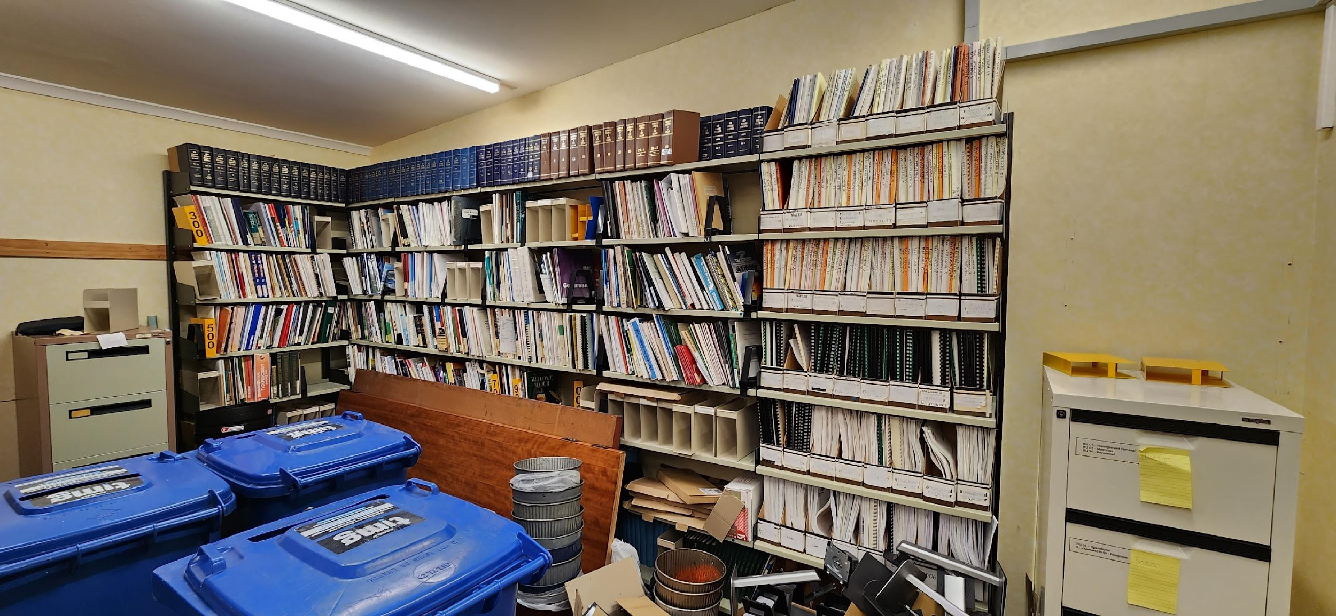
What not disposing regularly looks like…

Slide 10
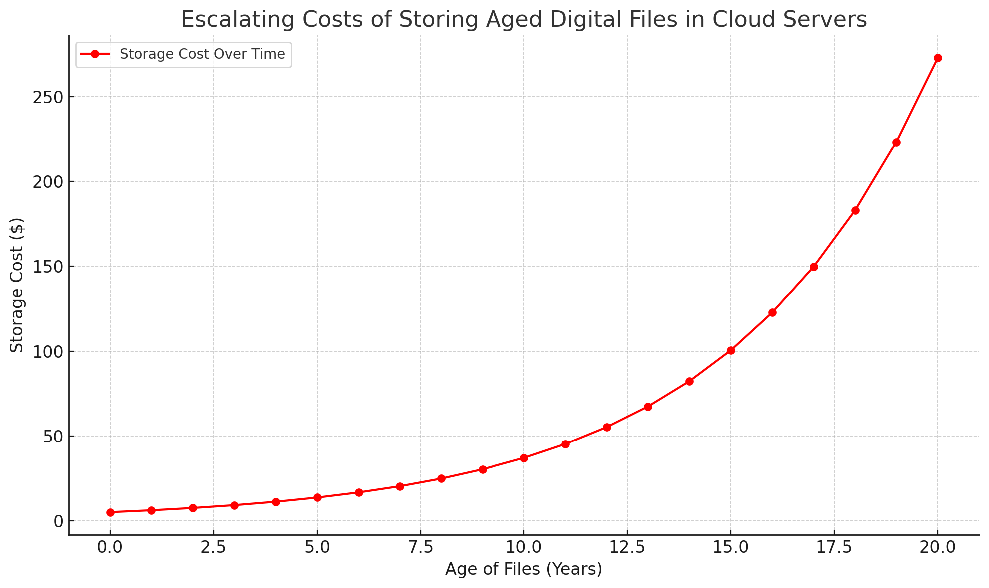
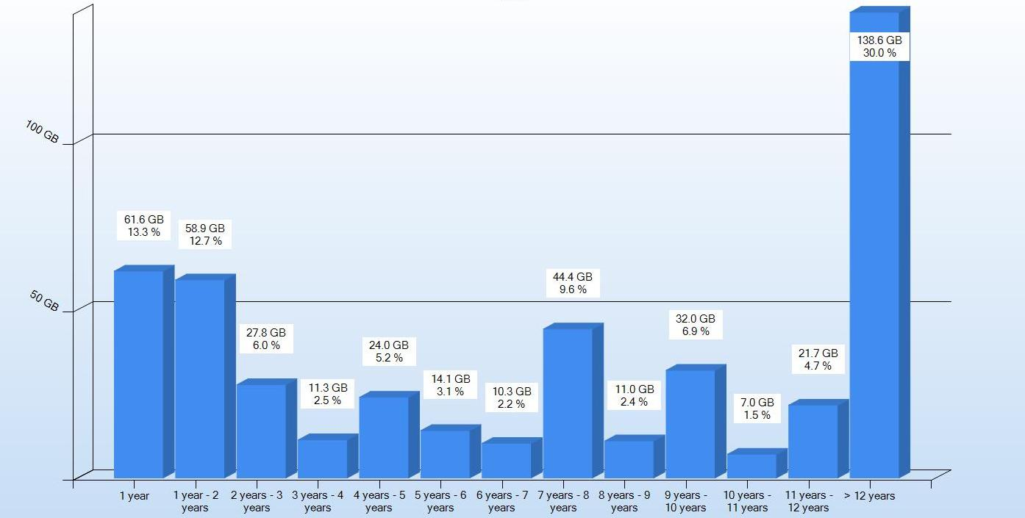
…and digitally…

Slide 11
Who does the Public Records Act 2005 (PRA) apply to?
Public offices are defined within Schedule 1 of the PRA, and include ministries, departments, Crown-owned entities, etc.
Local authorities are defined separately under the Local Government Act 2002, and for the PRA they are treated in a parallel but slightly different way.
Example: public offices can be audited by Archives New Zealand, but local authorities are only monitored.

Slide 12
Public Offices vs Local Authorities
Why the difference matters:
Public offices must transfer records sentenced as “Retain” or older than 25 years to Archives New Zealand, while local authorities retain their own archival holdings.
Different standards and guidelines can apply — although in practice, all should meeting similar expectations.

Slide 13
List of Protected Records
GDA6 & GDA7
Covered by Section 40 in the PRA
Specifies classes of local authority information and records which are worthy of preservation for administrative, accountability, heritage or research reasons
Great tool to start the identification of high-value/high-risk information to the local authority
Updated March 2024
Mandatory for public offices and provide ongoing authorisation for the disposal of common, non-core business information and records
GDA6 covers generic classes or types of information and records
Examples: Finance, HR files, IT, Property Management, etc.
GDA7 covers facilitative, transitory and short-term value information and records
Examples: Functions such as policy development, regulation, service delivery, etc.
Local authorities can use GDAs too

Slide 14
ALGIM T2 R&D Schedule
Utilises the LPR, GDA6 & GDA7 and relevant legislation to create an implementation schedule
Provides 18 “Retain” and 7 “Destruction” criteria
Template built to be flexible to allow modification to suit organisations (adapting sub-classes, +/- retention dates, grandfather dates, discretionary classes, etc)
Updated to coincide with LPR update (now on Version 8)

Slide 15
Disposal Action Options
Retain – either permanently or a set period of time
Destroy - Permanently destroy or delete the record once its required retention period is over.
Transfer - Move custody of the record to another entity, Archives New Zealand, or an approved repository
Deferral - Delay a planned disposal action for a justified reason
Alteration - Change the record (e.g. redacting, anonymising, or modifying) while retaining it
Discharge - Confirm that no further action is required under a schedule or disposal authority
Every disposal action must be authorised and documented. No action should happen casually or without a disposal authority.

Slide 16
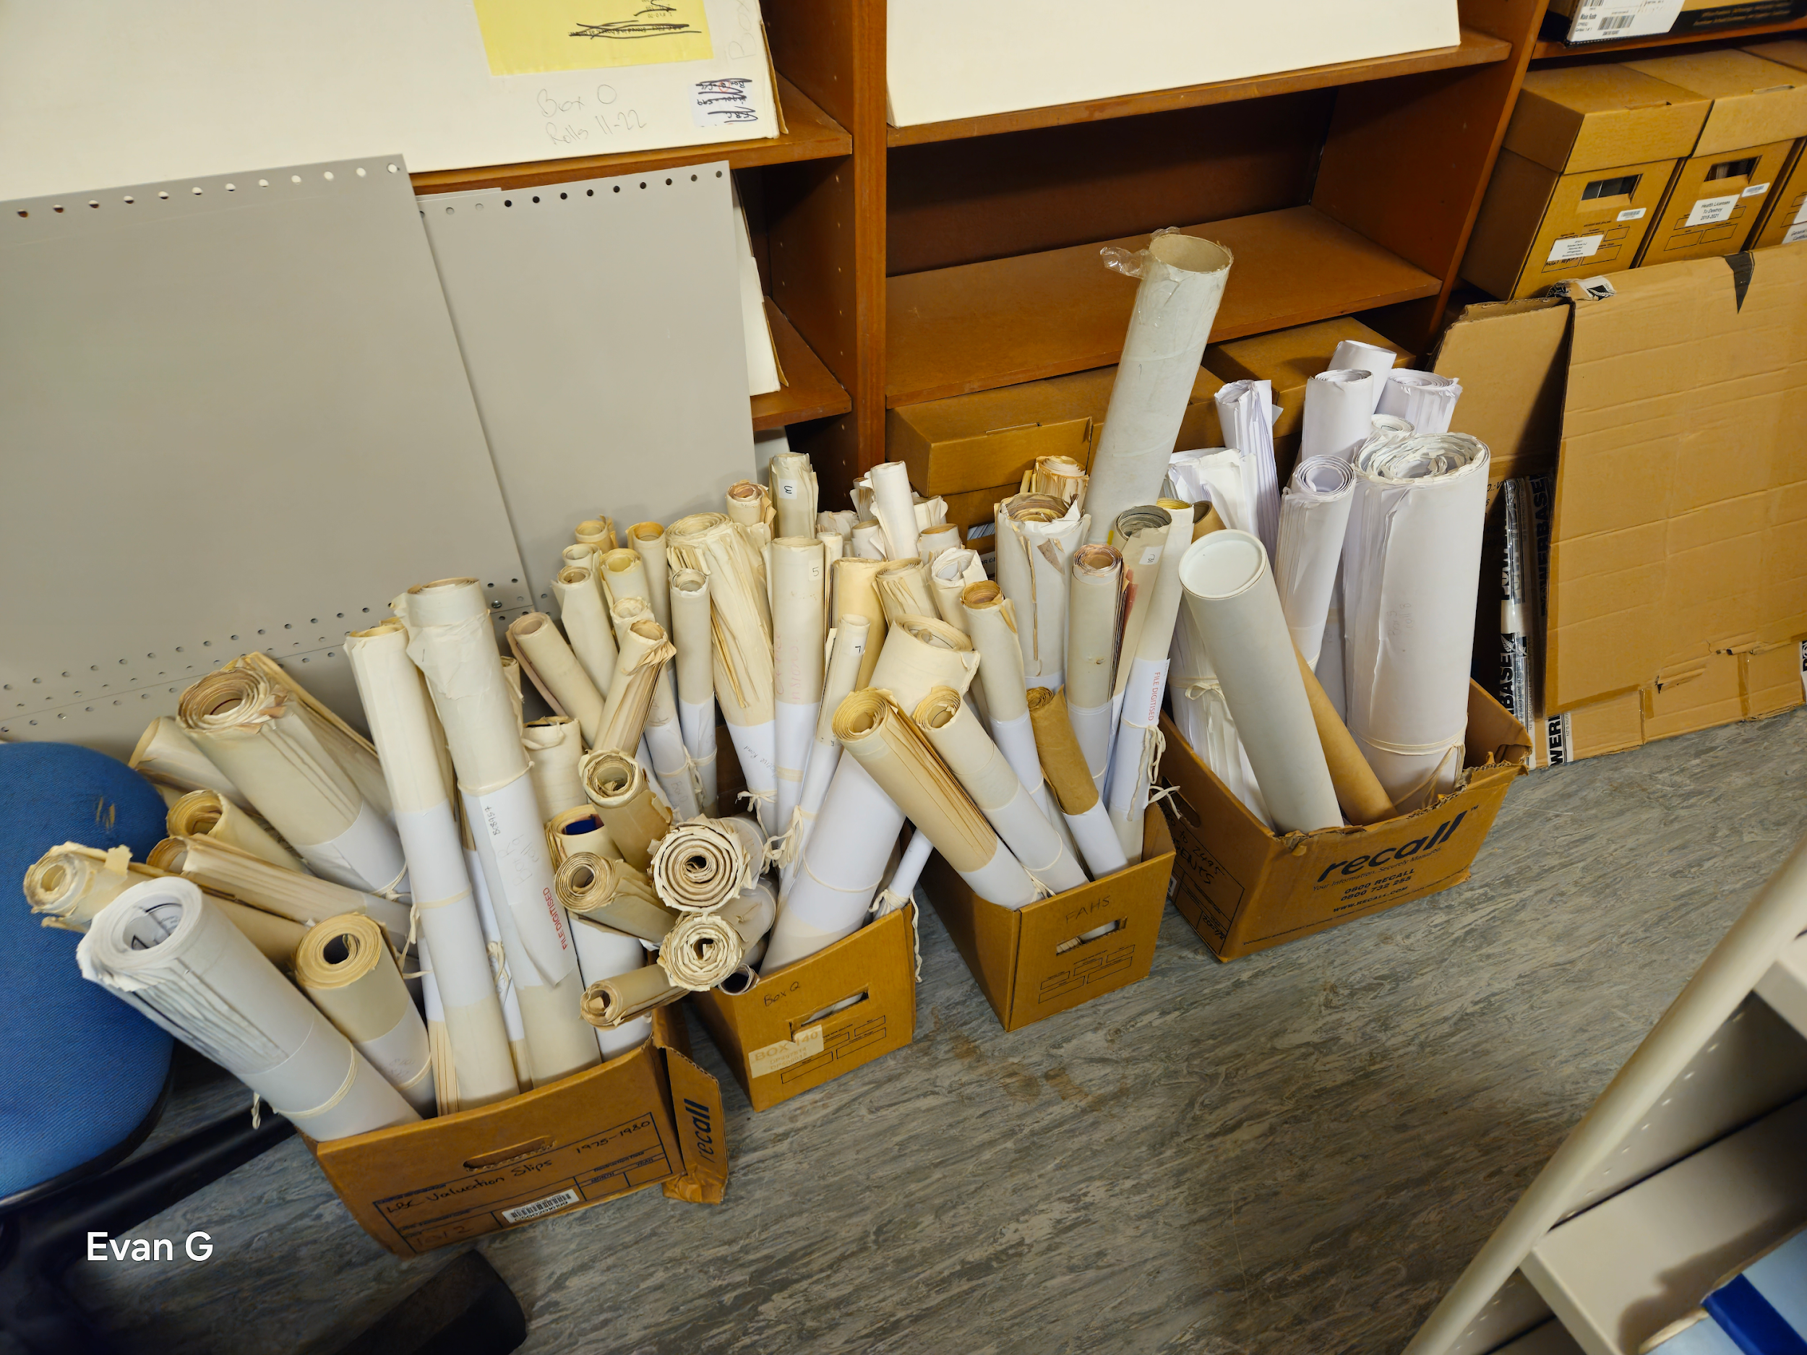
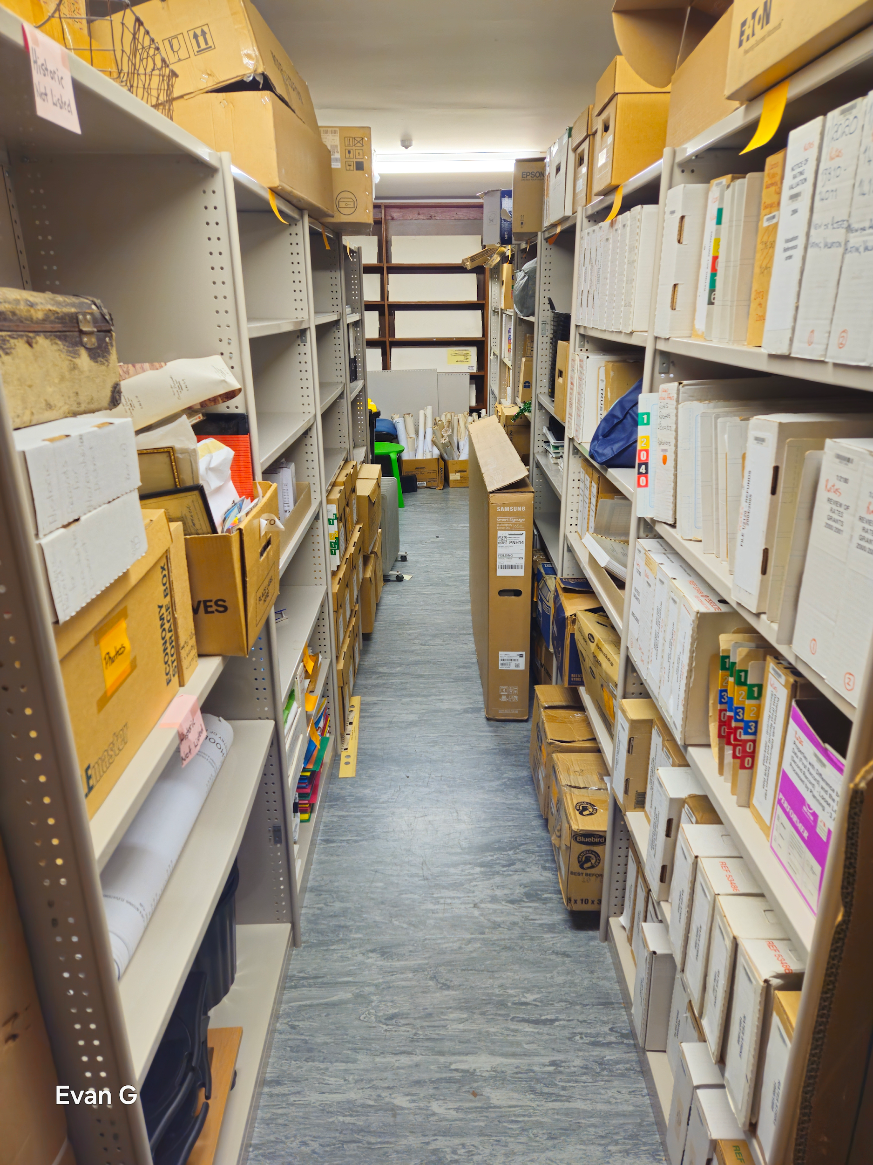
A Recent Example of Physical R&D and Transfer

Slide 17
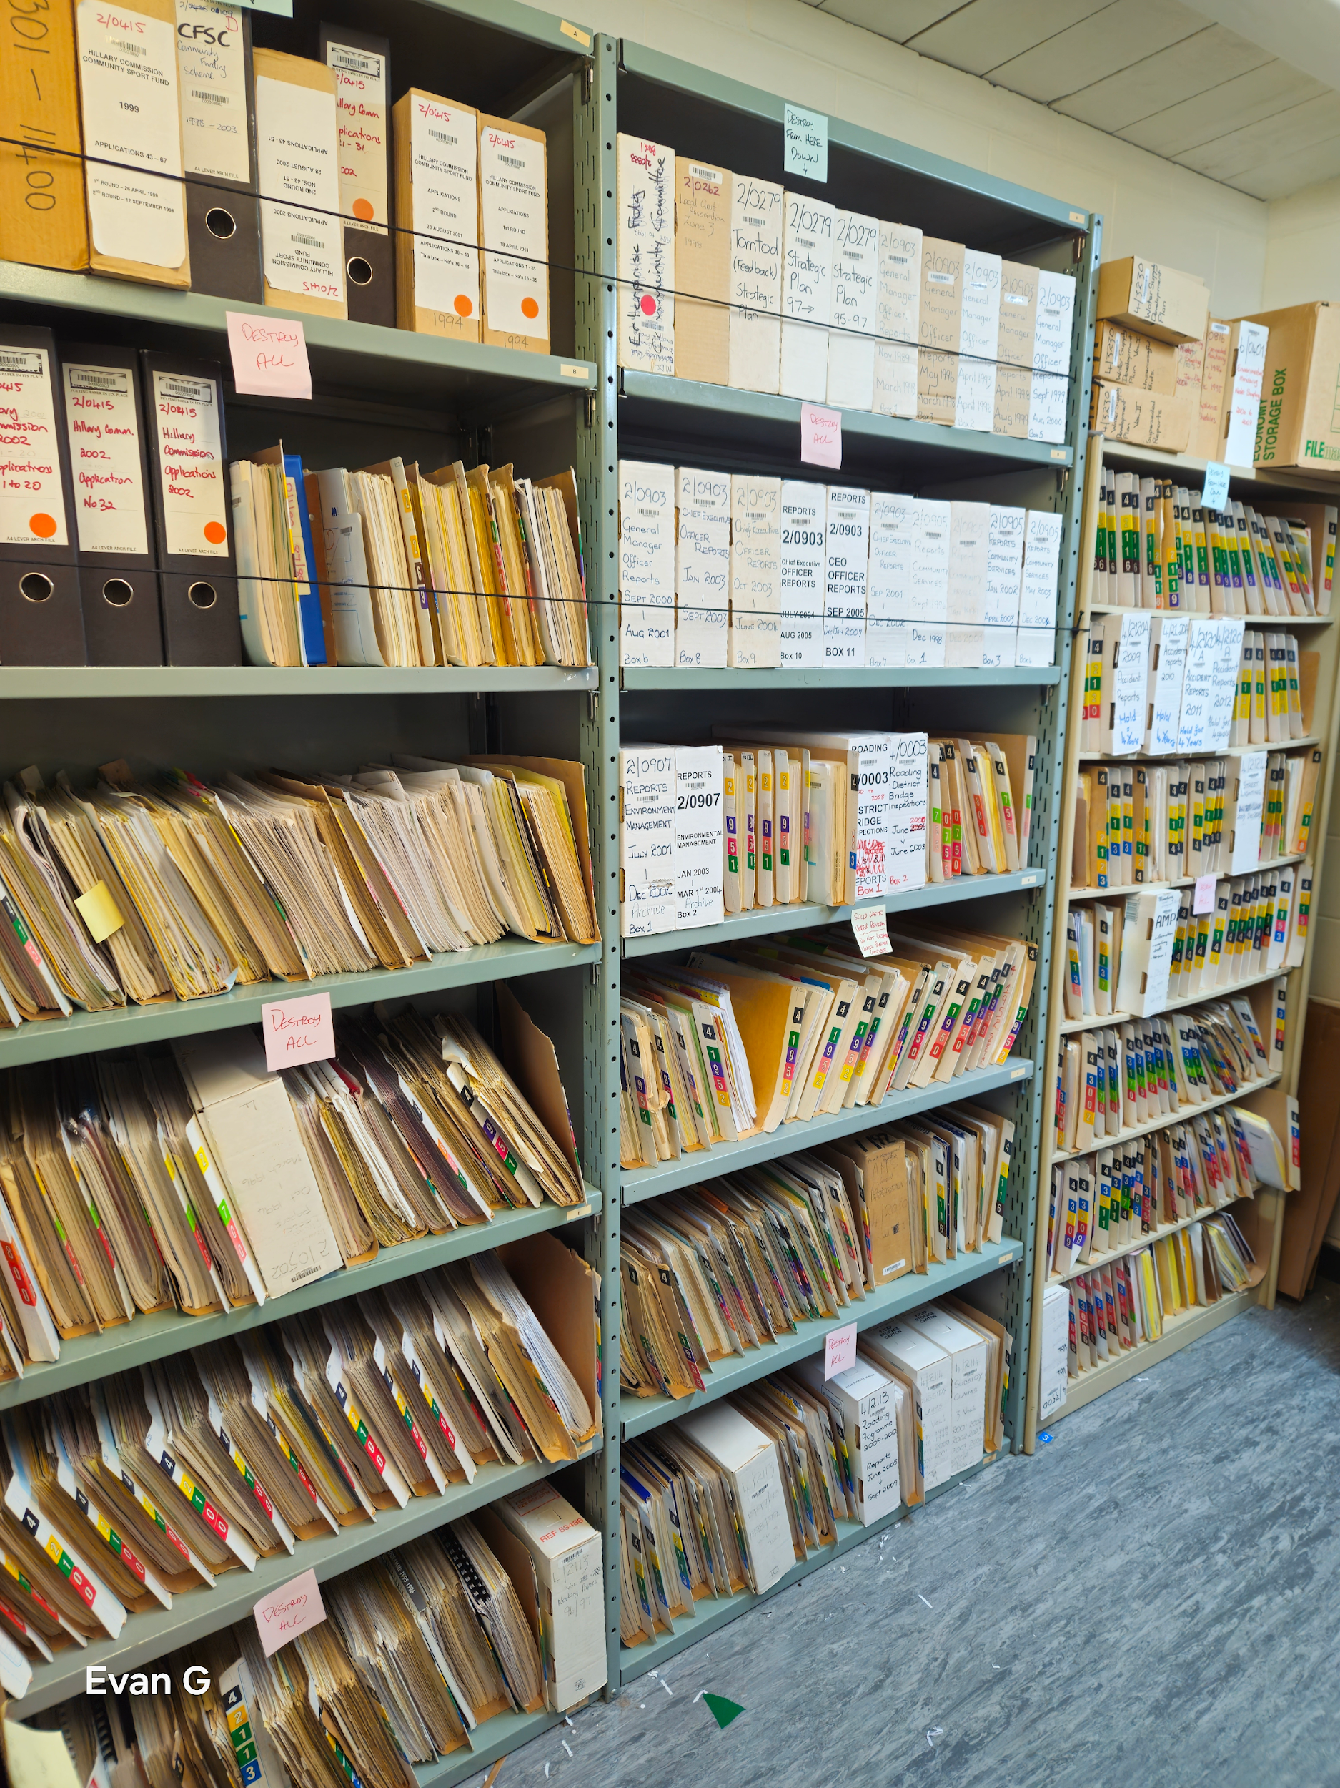

Slide 18
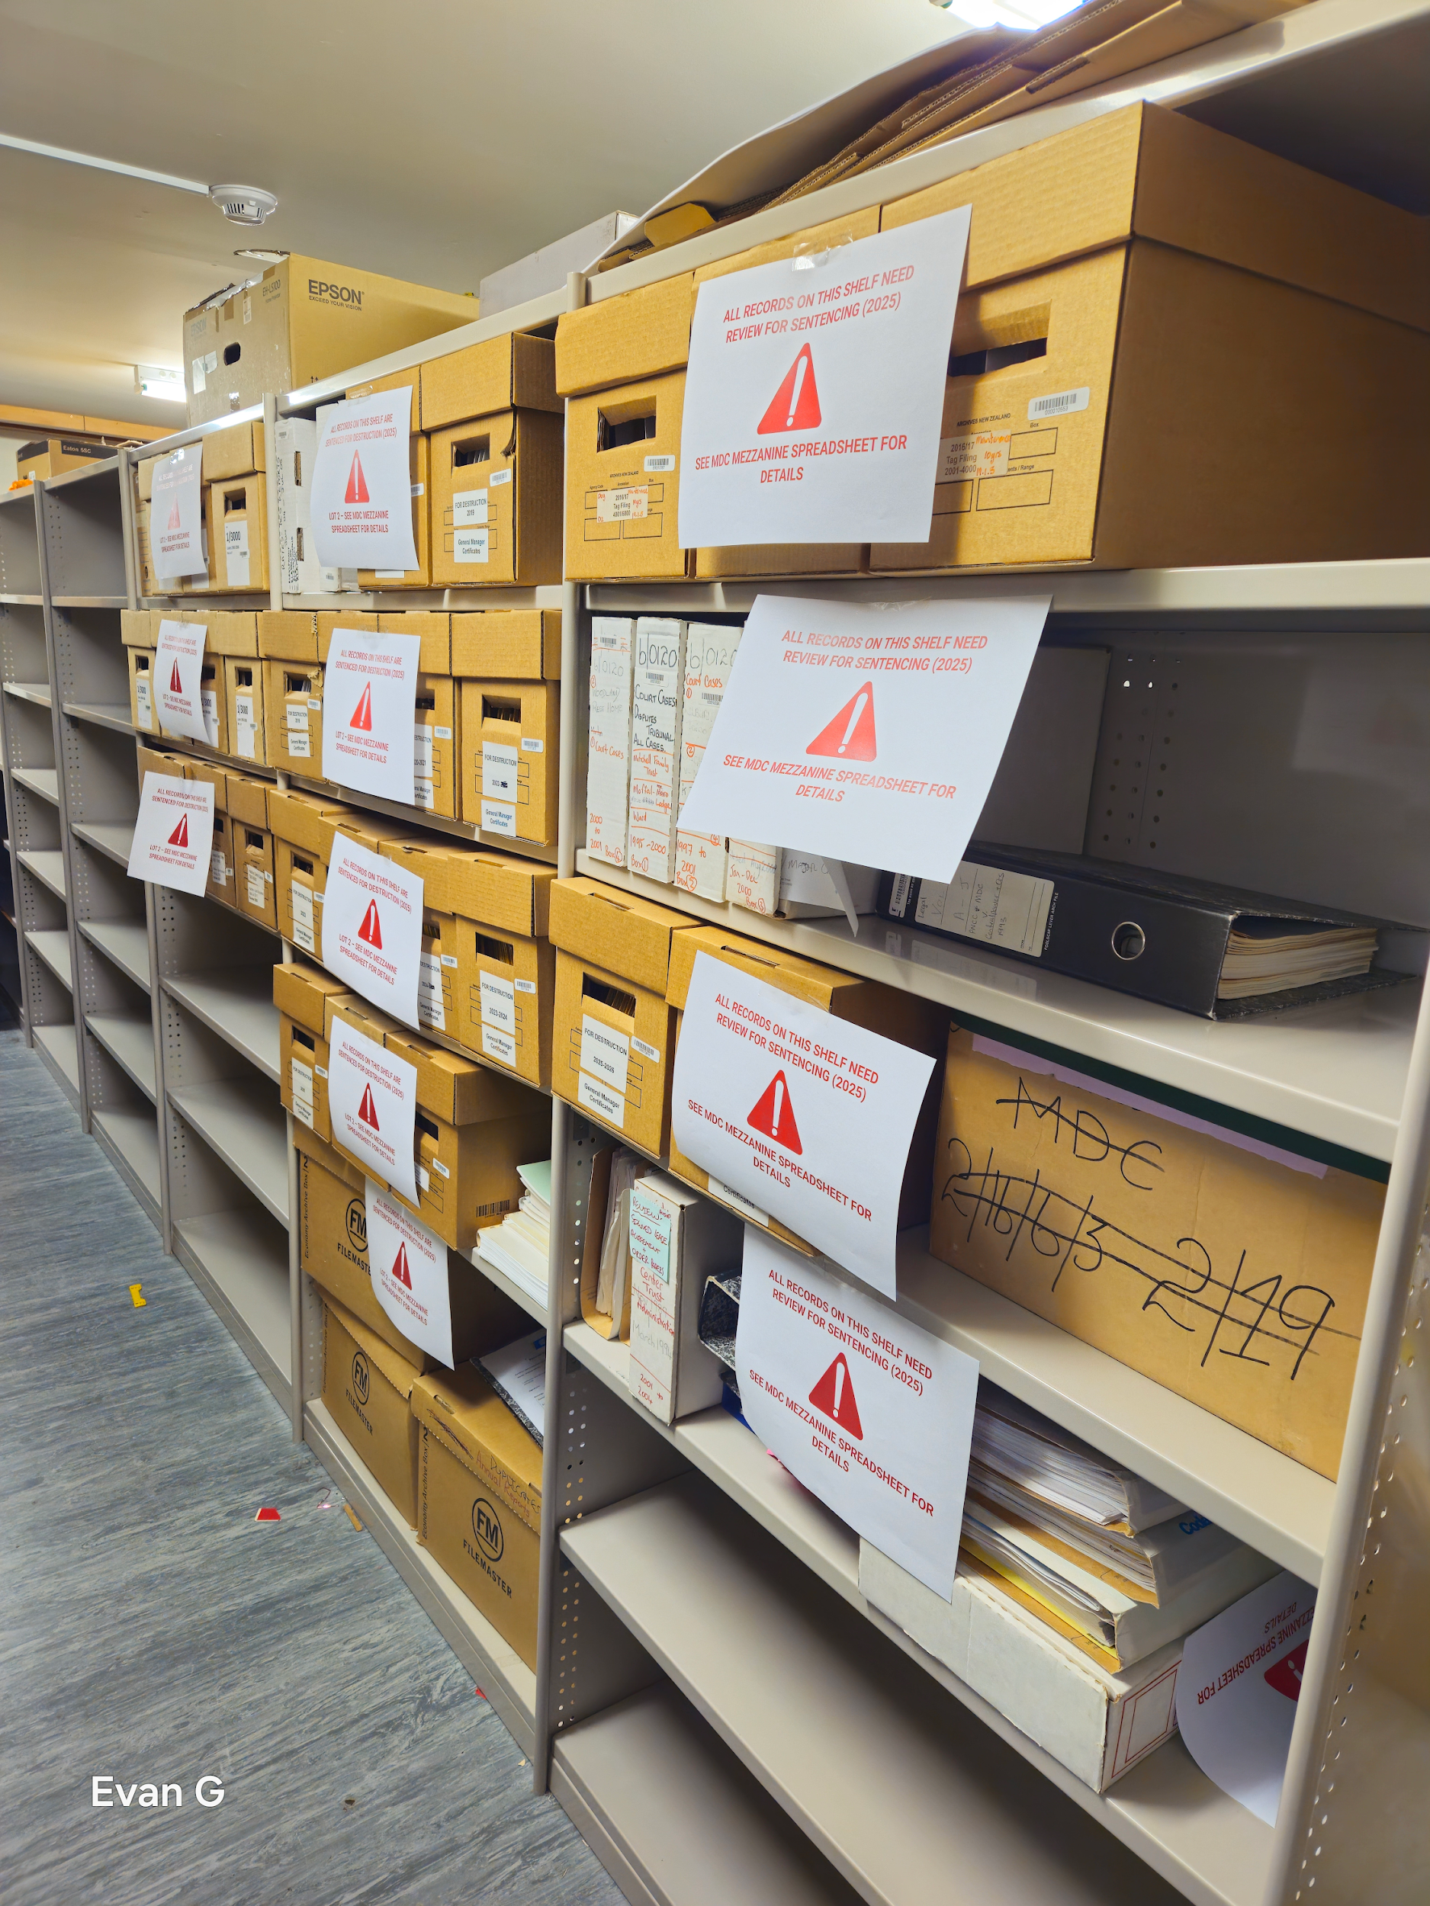

Slide 19
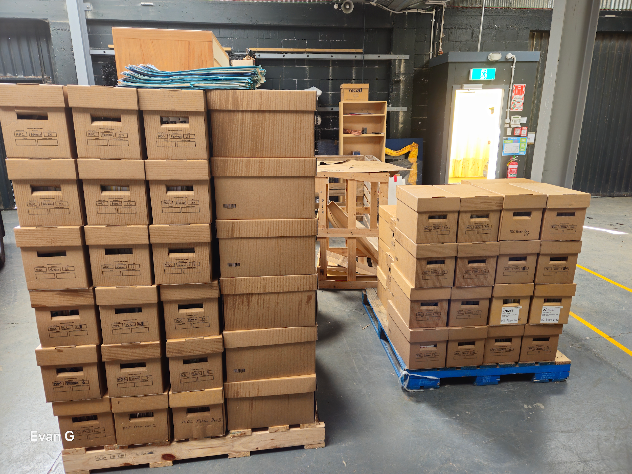

Slide 20
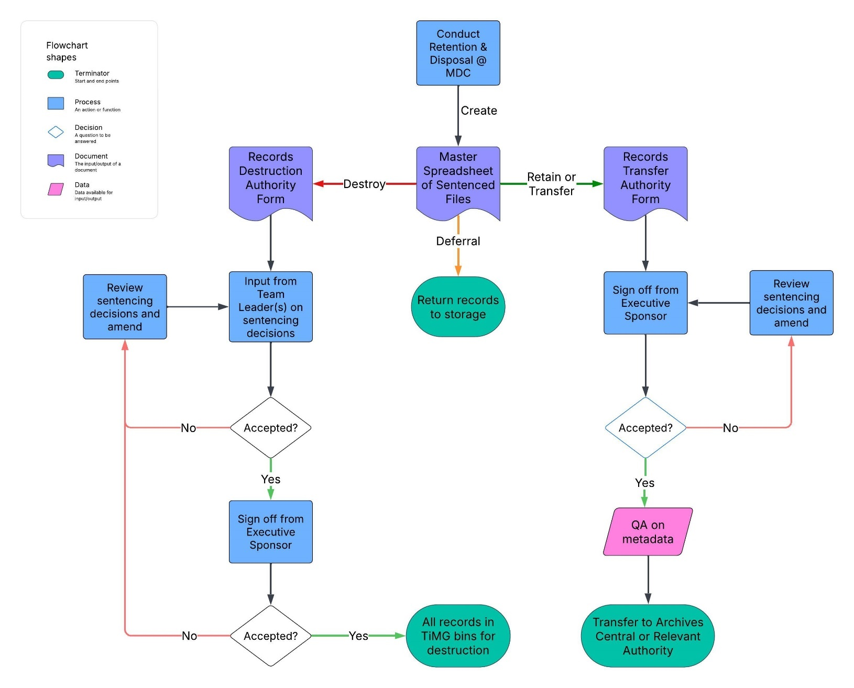
The Process Map

Slide 21
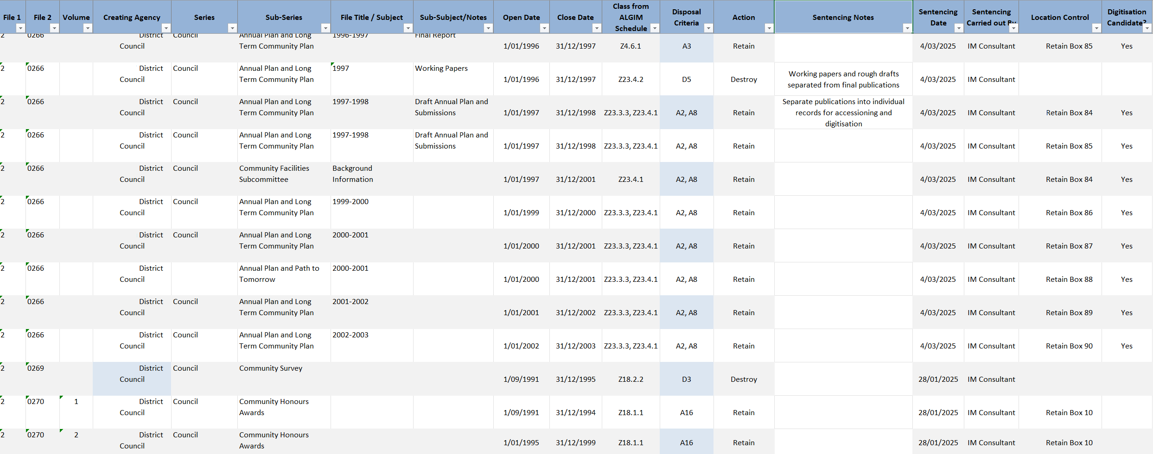
The Disposal Register

Slide 23
Approved Repositories
PRA, Section 26: (1)(a) The Minister may… approve a relevant body (such as a museum, a library, another archive, or an iwi-based or hapu-based repository) as an approved repository where public archives may be deposited for safekeeping

Slide 24
Approved Repositories
Can act as an archival material deposit taker
Responsible for ensuring the proper care and maintenance of the public archives they hold
Maintain appropriate public access Examples: Hocken Library, MTG Hawke’s Bay, Ngā Taonga Sound and Vision, etc.

Slide 25
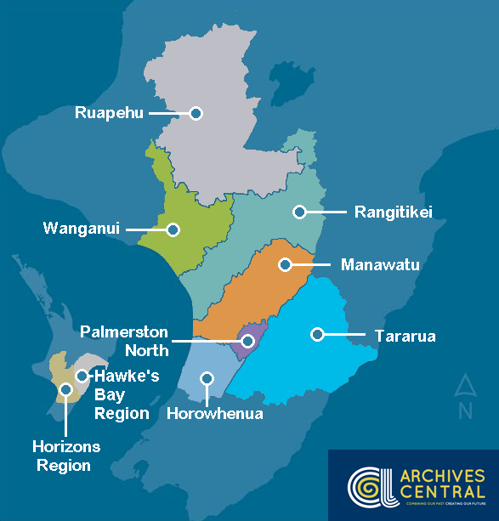
Archives Central
Run by MW LASS
Unique – only shared services archive in New Zealand
Digital and physical archival storage for 9 local authorities

Slide 26
Over 4,500+ linear meters of physical storage
Database stats:
235,000 digital records
4131 individual series
18,000+ media files
Conducts BAU archival functions
Also conducts special projects, such as Retention & Disposal, for member councils

Slide 27
Hawke’s Bay Regional Museum Research and Archives Centre
Collaboration between Hastings District and Napier City councils, Hawke’s Bay Museums Trust and Ngāti Kahungunu Iwi
90,000 items, with over 6,000 taonga tuku iho in the Taonga Māori Collection
To be completed by end of 2025

Slide 28
The Future Is Here - Digital Transfers
Archives NZ has received digital transfers and invites them - People think this is not the case!
First born-digital transfer occurred in 2009 - Political Papers: Speeches and press releases, Hon. Mahara Okeroa, MP

Slide 29
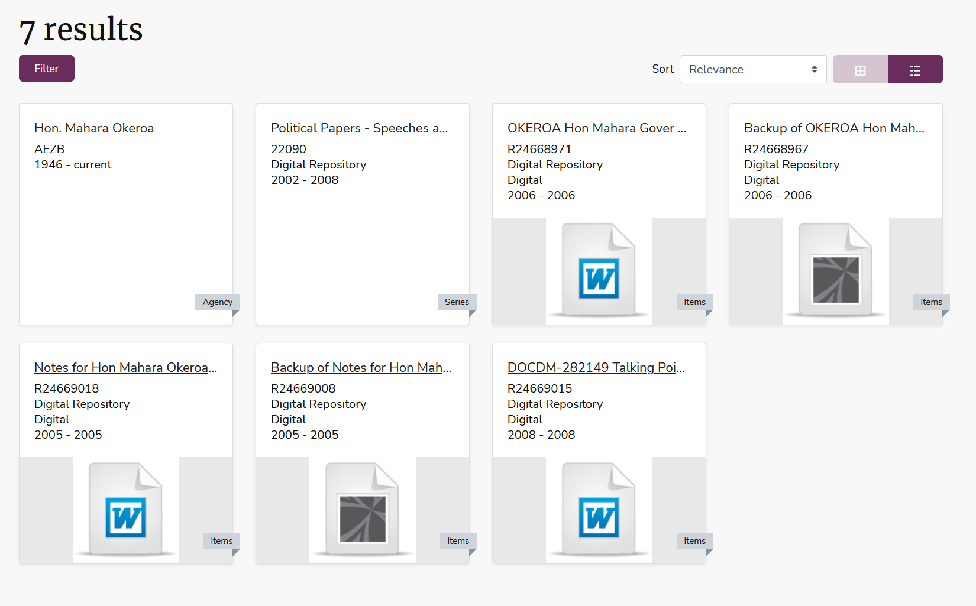

Slide 30
…but how?
Your local friendly NZ Archives Archivist will work through the process with you
Archives New Zealand has an extensive resource list which covers everything from transfer initiation to post-transfer support
Link: Digital Transfer Process

Slide 31
Disposal Requirements Include Metadata
“Create and maintain full and accurate records”
Metadata is part of the official record
When sentencing a record, treat the object and its metadata together

Slide 32
Minimum Metadata to Assign During Disposal
A handy guide from Archives New Zealand
Unique identifier
Name
Date created
Business activity documented
Creator (person or system)
Date of disposal
Authority governing the disposal
Person or role carrying out the disposal action

Slide 34
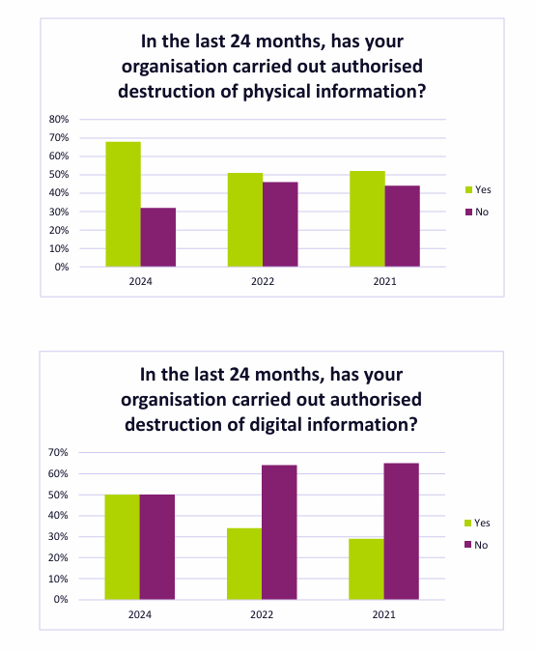
Report on the State of Government Recordkeeping 2023/24
Increase in percentage of organisation carrying out authorised destruction of physical and digital information

Slide 35
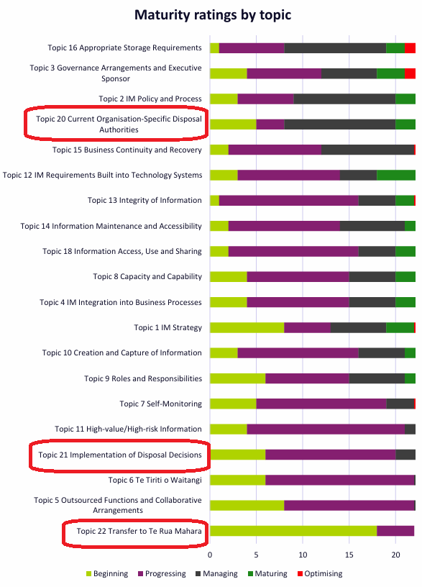
…but still a long way to go…

Slide 36
Final Recommendations for Managing Digital
Sentence aggregations based on highest value - e.g. folders or everything about a case in a database, etc.
Leave the conversations about file formats, data, to the experts - focus on the right outcome, according to the value of the information.
Digital archives can be made openly available for download from Archives New Zealand’s website. Discuss what outcome is right for your transfer.

Slide 37
Retention and Disposal: because even the Chief Archivist can't archive everything… including your excuses.

Slide 38
Thank You! Questions?

